Slide 1
Lecture 7: Clustering
[Borrows slides Pandu Nayak and Prabhakar Raghavan]

Slide 2
Today’s Topic: Clustering
Document clustering
  Motivations
  Document representations
  Success criteria
Clustering algorithms
  Partitional/Flat
  Hierarchical

Slide 3
What is clustering?
Ch. 16
Clustering: the process of grouping a set of objects into classes of similar objects
  Documents within a cluster should be similar.
  Documents from different clusters should be dissimilar.
The commonest form of unsupervised learning
    Unsupervised learning = learning from raw data, as opposed to supervised data where a classification of examples is given
  A common and important task that finds many applications in IR and other places

Slide 4
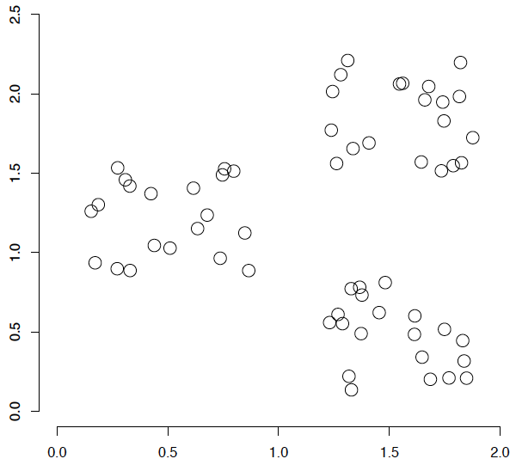
A data set with clear cluster structure
Ch. 16
How would you design an algorithm for finding the three clusters in this case?

Slide 5
Applications of clustering in IR
Sec. 16.1
Whole corpus analysis/navigation
  Better user interface: search without typing
For improving recall in search applications
  Better search results
For better navigation of search results
  Effective “user recall” will be higher
For speeding up vector space retrieval
  Cluster-based retrieval gives faster search

Slide 6
Yahoo! Hierarchy isn’t clustering but is the kind of output you want from clustering
www.yahoo.com/Science
… (30)
agriculture
biology
physics
CS
space
...
...
...
...
...
dairy
crops
botany
cell
AI
courses
craft
magnetism
HCI
missions
forestry
agronomy
evolution
relativity
Notes:
Final data set:
Yahoo Science hierarchy, consisting of text of web pages pointed to by Yahoo, gathered summer of 1997.
264 classes, only sample shown here.

Slide 7
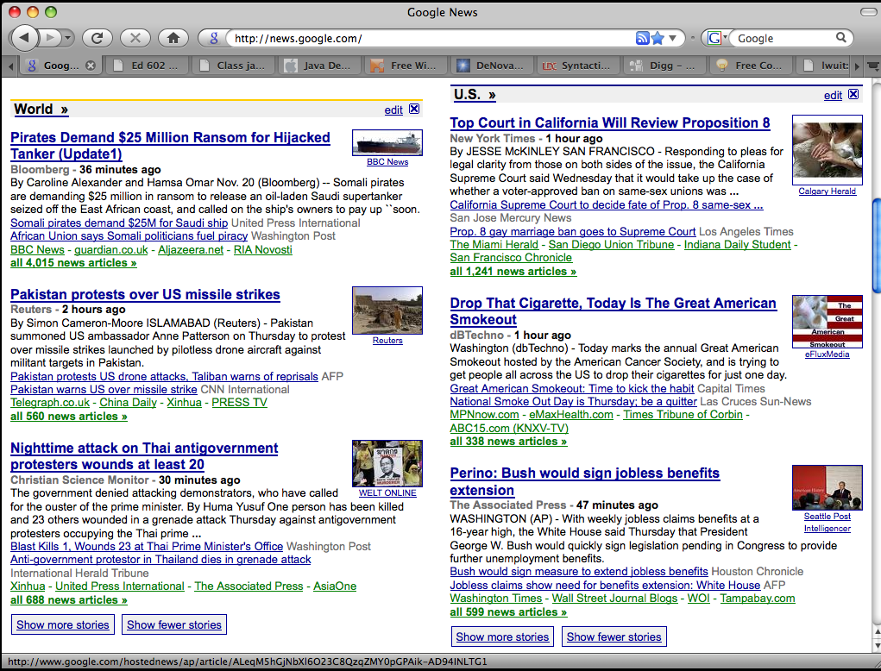
Google News: automatic clustering gives an effective news presentation metaphor

Slide 8
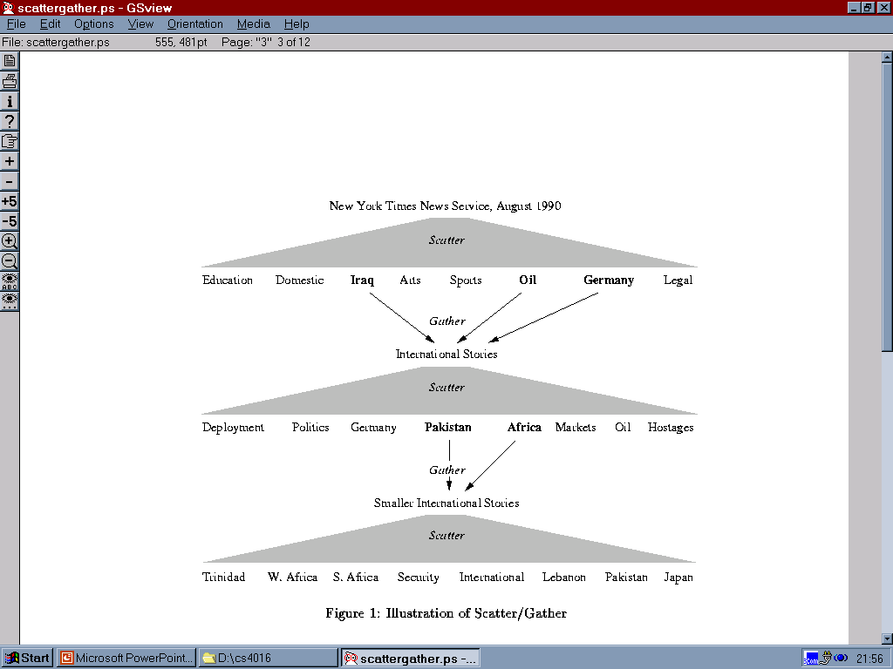
Scatter/Gather: Cutting, Karger, and Pedersen
Sec. 16.1

Slide 9
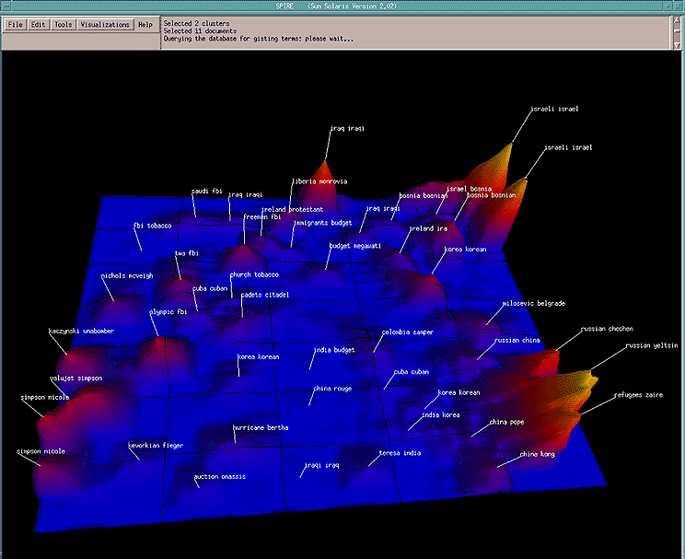
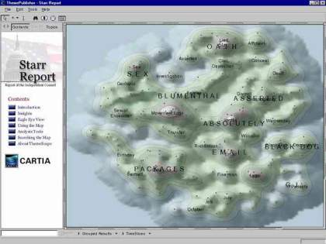
For visualizing a document collection and its themes
Wise et al, “Visualizing the non-visual” PNNL
ThemeScapes, Cartia
  [Mountain height = cluster size]

Slide 10
For improving search recall
Sec. 16.1
Cluster hypothesis - Documents in the same cluster behave similarly with respect to relevance to information needs
Therefore, to improve search recall:
  Cluster docs in corpus a priori
  When a query matches a doc D, also return other docs in the cluster containing D
Hope if we do this: The query “car” will also return docs containing automobile
  Because clustering grouped together docs containing car with those containing automobile.
Why might this happen?

Slide 11
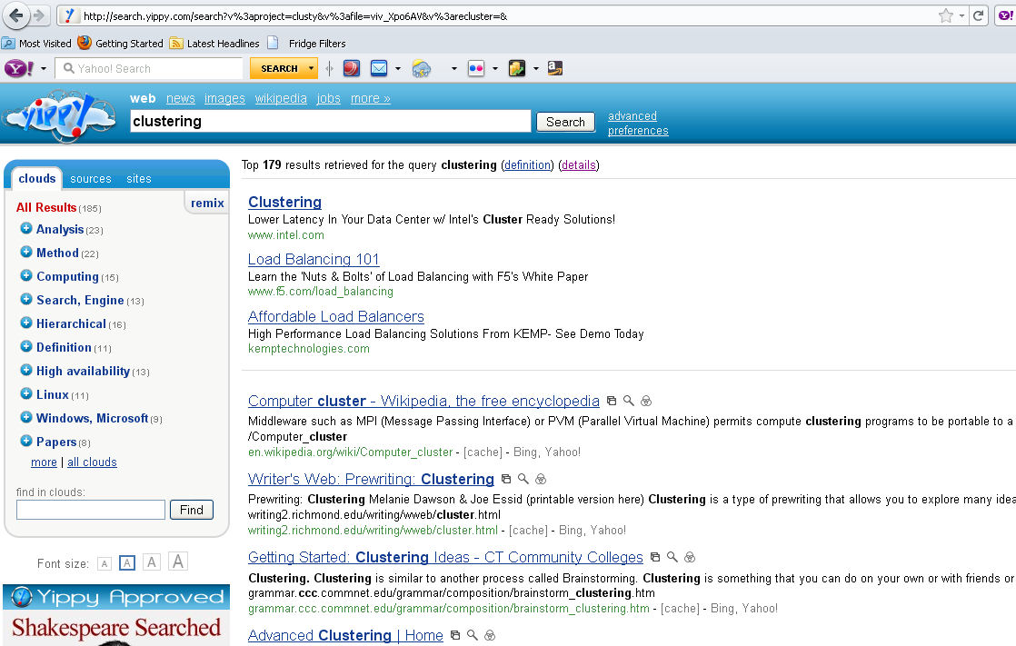
yippy.com – grouping search results

Slide 12
Issues for clustering
Sec. 16.2
Representation for clustering
  Document representation
    Vector space? Normalization?
      Centroids aren’t length normalized
  Need a notion of similarity/distance
How many clusters?
  Fixed a priori?
  Completely data driven?
    Avoid “trivial” clusters - too large or small
      If a cluster's too large, then for navigation purposes you've wasted an extra user click without whittling down the set of documents much.

Slide 13
Notion of similarity/distance
Ideal: semantic similarity.
Practical: term-statistical similarity
  We will use cosine similarity.
  Docs as vectors.
  For many algorithms, easier to think in terms of a distance (rather than similarity) between docs.
  We will mostly speak of Euclidean distance
    But real implementations use cosine similarity

Slide 14
Clustering Algorithms
Flat algorithms
  Usually start with a random (partial) partitioning
  Refine it iteratively
    K means clustering
    (Model based clustering)
Hierarchical algorithms
  Bottom-up, agglomerative
  (Top-down, divisive)

Slide 15
Hard vs. soft clustering
Hard clustering: Each document belongs to exactly one cluster
  More common and easier to do
Soft clustering: A document can belong to more than one cluster.
  Makes more sense for applications like creating browsable hierarchies
  You may want to put a pair of sneakers in two clusters: (i) sports apparel and (ii) shoes
  You can only do that with a soft clustering approach.

Slide 16
Partitioning Algorithms
Partitioning method: Construct a partition of n documents into a set of K clusters
Given: a set of documents and the number K
Find: a partition of K clusters that optimizes the chosen partitioning criterion
  Globally optimal
    Intractable for many objective functions
    enumerate all partitions?
  Effective heuristic methods: K-means and K-medoids algorithms

Slide 17
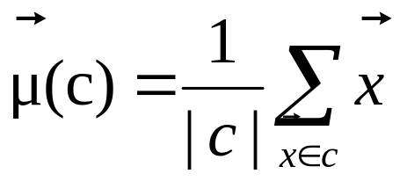
K-Means
Sec. 16.4
Assumes documents are real-valued vectors.
Clusters based on centroids (aka the center of gravity or mean) of points in a cluster, c:
Reassignment of instances to clusters is based on distance to the current cluster centroids.
  (Or one can equivalently phrase it in terms of similarities)

Slide 18
K-Means Algorithm
Sec. 16.4
Select K random docs {s₁, s₂,… s_{K}} as seeds.
Until clustering converges (or other stopping criterion):
For each doc d_{i}:
Assign d_{i} to the cluster c_{j} such that dist(x_{i}, s_{j}) is minimal.
(Next, update the seeds to the centroid of each cluster)
For each cluster c_{j}
s_{j} = μ(c_{j})

Slide 19
K Means Example
(K=2)
Sec. 16.4
Pick seeds
Reassign clusters
Compute centroids
Reassign clusters
x
x
x
Compute centroids
x
x
x
Reassign clusters
Converged!

Slide 20
Termination conditions
Sec. 16.4
Several possibilities, e.g.,
  A fixed number of iterations.
  Doc partition unchanged.
  Centroid positions don’t change.
Does this mean that the docs in a cluster are unchanged?

Slide 21
Convergence
Sec. 16.4
Why should the K-means algorithm ever reach a fixed point?
  A state in which clusters don’t change.
K-means is a special case of a general procedure known as the Expectation Maximization (EM) algorithm.
  EM is known to converge.
  Number of iterations could be large.
      But in practice usually isn’t

Slide 22
Convergence of K-Means
Sec. 16.4
Lower case!
Define goodness measure of cluster k as sum of squared distances from cluster centroid:
  G_{k} = Σ_{i} (d_{i} – c_{k})² (sum over all d_{i} in cluster k)
G = Σ_{k} G_{k}
Reassignment monotonically decreases G since each vector is assigned to the closest centroid.

Slide 23
Convergence of K-Means
Sec. 16.4
Recomputation monotonically decreases each G_{k} since (m_{k} is number of members in cluster k):
  Σ (d_{i} – a)² reaches minimum for:
  Σ 2(d_{i} – a) = 0
  Σ d_{i} = Σ a
  m_{K} a = Σ d_{i}
  a = (1/ m_{k}) Σ d_{i} = c_{k}
K-means typically converges quickly

Slide 24
Time Complexity
Sec. 16.4
Computing distance between two docs is O(M) where M is the dimensionality of the vectors.
Reassigning clusters: O(KN) distance computations, or O(KNM).
Computing centroids: Each doc gets added once to some centroid: O(NM).
Assume these two steps are each done once for I iterations: O(IKNM).

Slide 25

Seed Choice
Sec. 16.4
Results can vary based on random seed selection.
Some seeds can result in poor convergence rate, or convergence to sub-optimal clusterings.
  Select good seeds using a heuristic (e.g., doc least similar to any existing mean)
  Try out multiple starting points
  Initialize with the results of another method.
Example showing
sensitivity to seeds
In the above, if you start
with B and E as centroids
you converge to {A,B,C}
and {D,E,F}
If you start with D and F
you converge to
{A,B,D,E} {C,F}

Slide 26
Seed Choice
Sec. 16.4
Results can vary based on random seed selection.
Some seeds can result in poor convergence rate, or convergence to sub-optimal clusterings.
  Select good seeds using a heuristic (e.g., doc least similar to any existing mean)
  Try out multiple starting points
  Initialize with the results of another method.
Example showing
sensitivity to seeds
In the above, if you start
with B and E as centroids
you converge to {A,B,C}
and {D,E,F}
If you start with D and F
you converge to
{A,B,D,E} {C,F}

Slide 27
K-means issues, variations, etc.
Sec. 16.4
Recomputing the centroid after every assignment (rather than after all points are re-assigned) can improve speed of convergence of K-means
Assumes clusters are spherical in vector space
  Sensitive to coordinate changes, weighting etc.
Disjoint and exhaustive
  Doesn’t have a notion of “outliers” by default
  But can add outlier filtering
Dhillon et al. ICDM 2002 – variation to fix some issues with small
document clusters

Slide 28
Cardinality - How Many Clusters?
Number of clusters K is given
  Partition n docs into predetermined number of clusters
Finding the “right” number of clusters is part of the problem
  Given docs, partition into an “appropriate” number of subsets.
  E.g., for query results - ideal value of K not known up front - though UI may impose limits.
Can usually take an algorithm for one flavor and convert to the other.

Slide 29
K not specified in advance
Solve an optimization problem: penalize having lots of clusters
  application dependent, e.g., compressed summary of search results list.
Tradeoff between having more clusters (better focus within each cluster) and having too many clusters

Slide 30
K not specified in advance
Given a clustering, define the Benefit for a doc to be the cosine similarity to its centroid
Define the Total Benefit to be the sum of the individual doc Benefits.
Why is there always a clustering of Total Benefit n?

Slide 31
Penalize lots of clusters
For each cluster, we have a Cost C.
Thus for a clustering with K clusters, the Total Cost is KC.
Define the Value of a clustering to be =
  Total Benefit - Total Cost.
Find the clustering of highest value, over all choices of K.
  Total benefit increases with increasing K. But can stop when it doesn’t increase by “much”. The Cost term enforces this.

Slide 32
Hierarchical Clustering
Ch. 17
Build a tree-based hierarchical taxonomy (dendrogram) from a set of documents.
One approach: recursive application of a partitional clustering algorithm.
animal
vertebrate
invertebrate
fish reptile amphib. mammal worm insect crustacean

Slide 33
Dendrogram: Hierarchical Clustering
  Clustering obtained by cutting the dendrogram at a desired level: each connected component forms a cluster.

Slide 34
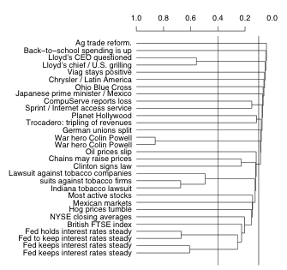
A dendogram
  The history of mergers can be read off from bottom to top.
  The horizontal line of each merger tells us what the similarity of the merger was.
  We can cut the dendrogram at a particular point (e.g., at 0.1 or 0.4) to get a flat clustering.

Slide 35
Hierarchical Agglomerative Clustering (HAC)
Sec. 17.1
Starts with each doc in a separate cluster
  then repeatedly joins the closest pair of clusters, until there is only one cluster.
The history of merging forms a binary tree or hierarchy.

Slide 36
Closest pair of clusters
Sec. 17.2
Many variants to defining closest pair of clusters
Single-link
  Similarity of the most cosine-similar (single-link)
Complete-link
  Similarity of the “furthest” points, the least cosine-similar
Centroid
  Clusters whose centroids (centers of gravity) are the most cosine-similar
Average-link
  Average cosine between pairs of elements

Slide 37
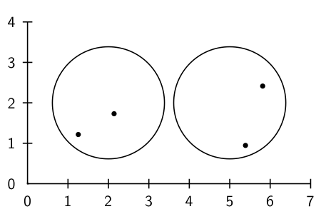
Cluster similarity: Example

Slide 38
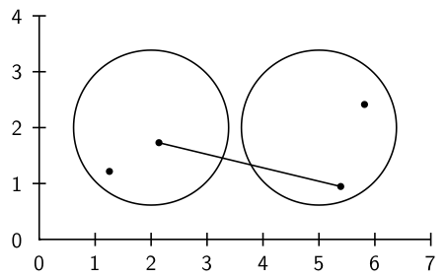
Single-link: Maximum similarity

Slide 39
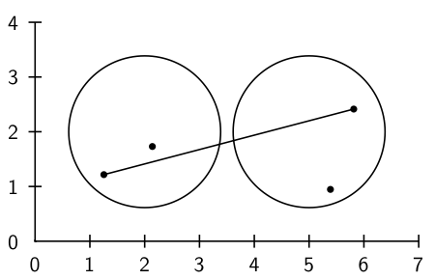
Complete-link: Minimum similarity

Slide 40
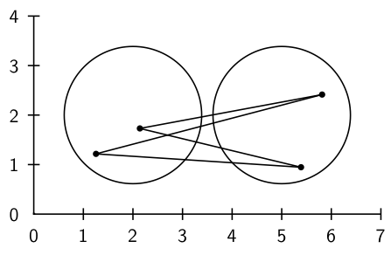
Centroid: Average intersimilarity
intersimilarity = similarity of two documents in different clusters

Slide 41
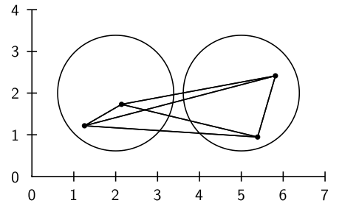
Group average: Average intrasimilarity
intrasimilarity = similarity of any pair, including cases where the
two documents are in the same cluster

Slide 42
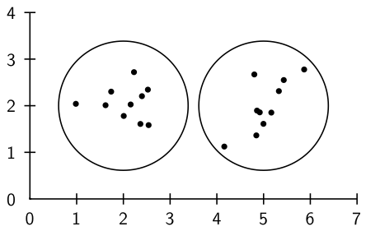
Cluster similarity: Larger Example

Slide 43
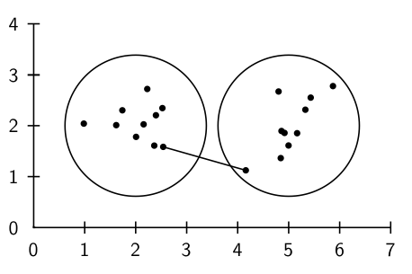
Single-link: Maximum similarity

Slide 44
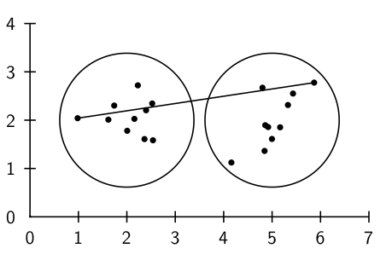
Complete-link: Minimum similarity

Slide 45
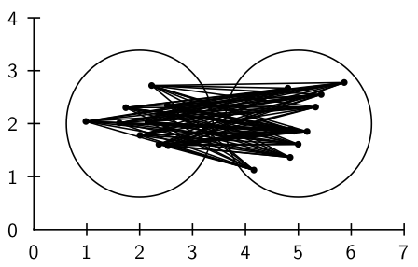
Centroid: Average intersimilarity

Slide 46
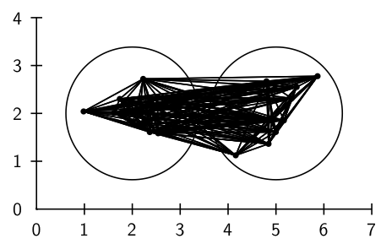
Group average: Average intrasimilarity

Slide 47
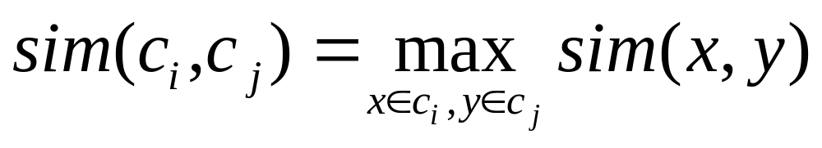
Single Link Agglomerative Clustering
Sec. 17.2
Use maximum similarity of pairs:
Can result in “straggly” (long and thin) clusters due to chaining effect.
After merging c_{i} and c_{j}, the similarity of the resulting cluster to another cluster, c_{k}, is:

Slide 48
Single Link Example
Sec. 17.2

Slide 49
This dendogram was produced by single-link
  Notice: many small clusters (1 or 2 members) being added to the main cluster
  There is no balanced 2-cluster or 3-cluster clustering that can be derived by cutting the dendrogram.

Slide 50
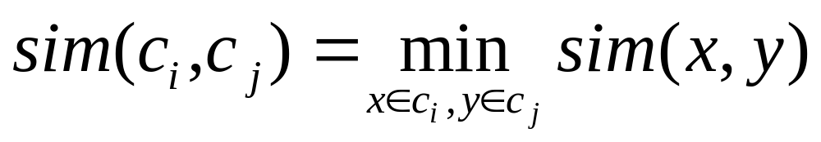
Complete Link
Sec. 17.2
Use minimum similarity of pairs:
Makes “tighter,” spherical clusters that are typically preferable.
After merging c_{i} and c_{j}, the similarity of the resulting cluster to another cluster, c_{k}, is:
C_{i}
C_{j}
C_{k}

Slide 51
Complete Link Example
Sec. 17.2

Slide 52
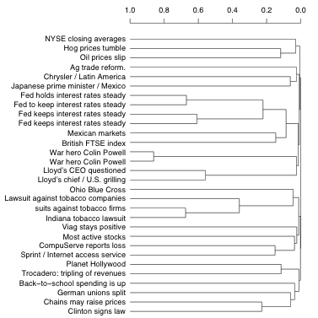
Complete-link dendrogram
  Notice that this dendrogram is much more balanced than the single-link one.
  We can create a 2-cluster clustering with two clusters of about the same size.

Slide 53
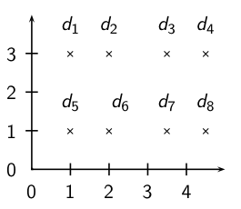
Exercise: Compute single and complete link clustering

Slide 54
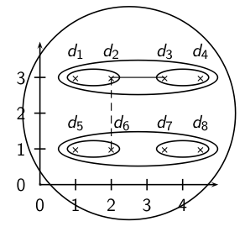
Single-link clustering

Slide 55
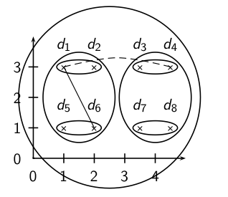
Complete link clustering

Slide 56
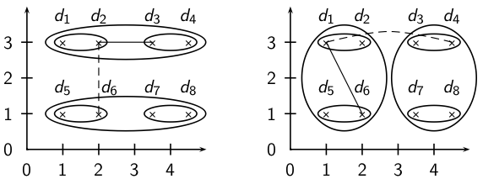
Single-link vs. Complete link clustering

Slide 57
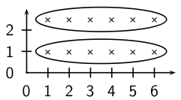
Single-link: Chaining
Single-link clustering often produces long, straggly clusters. For most applications, these are undesirable.

Slide 58
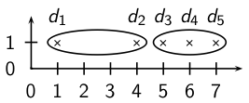
What 2-cluster clustering will complete-link produce?

Slide 59
Complete-link: Sensitivity to outliers
  The complete-link clustering of this set splits d₂ from its right neighbors – clearly undesirable.
  The reason is the outlier d₁.
  This shows that a single outlier can negatively affect the outcome of complete-link clustering.
  Single-link clustering does better in this case.

Slide 60
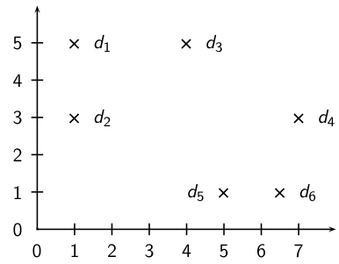
Exercise: Compute centroid clustering

Slide 61
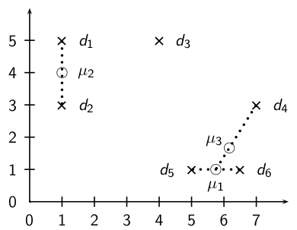
Centroid clustering

Slide 62
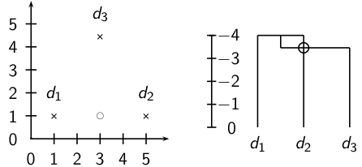
The Inversion in centroid clustering
  In an inversion, the similarity increases during a merge sequence. Results in an “inverted” dendrogram.
  Below: Similarity of the first merger (d₁ ∪ d₂) is -4.0, similarity of second merger ((d₁ ∪ d₂) ∪ d₃) is ≈ −3.5.

Slide 63
Inversions
  Hierarchical clustering algorithms that allow inversions are inferior.
  The rationale for hierarchical clustering is that at any given point, we’ve found the most coherent clustering of a given size.
  Intuitively: smaller clusterings should be more coherent than larger clusterings.
  An inversion contradicts this intuition: we have a large cluster that is more coherent than one of its subclusters.

Slide 64
Computational Complexity
Sec. 17.2.1
In the first iteration, all HAC methods need to compute similarity of all pairs of N initial instances, which is O(N²).
In each of the subsequent N−2 merging iterations, compute the distance between the most recently created cluster and all other existing clusters.
In order to maintain an overall O(N²) performance, computing similarity to each other cluster must be done in constant time.
  Often O(N³) if done naively or O(N² log N) if done more cleverly

Slide 65
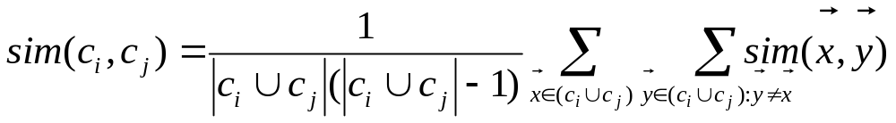
Group Average
Sec. 17.3
Similarity of two clusters = average similarity of all pairs within merged cluster.
Compromise between single and complete link.
Two options:
  Averaged across all ordered pairs in the merged cluster
  Averaged over all pairs between the two original clusters
No clear difference in efficiency

Slide 66
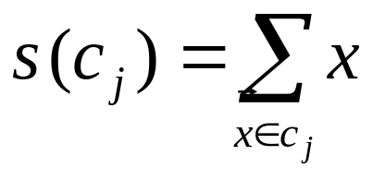
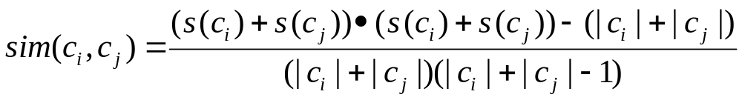
Computing Group Average Similarity
Sec. 17.3
Always maintain sum of vectors in each cluster.
Compute similarity of clusters in constant time:
Notes:
Sum of individual vector similarities is equal to the similarities of their sums

Slide 67
Group-average agglomerative clustering (GAAC)
  GAAC also has an “average-similarity” criterion, but does not have inversions.
  The similarity of two clusters is the average intrasimilarity – the average similarity of all document pairs (including those from the same cluster).
  But we exclude self-similarities.

Slide 68
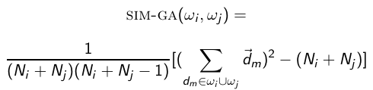
Group-average agglomerative clustering (GAAC)
  Again, a naive implementation is inefficient (O(N²)) and there is an equivalent, more efficient, centroid-based definition:
  Again, this is the dot product, not cosine similarity.

Slide 69
What Is A Good Clustering?
Sec. 16.3
Internal criterion: A good clustering will produce high quality clusters in which:
  the intra-class (that is, intra-cluster) similarity is high
  the inter-class similarity is low
  The measured quality of a clustering depends on both the document representation and the similarity measure used

Slide 70
External criteria for clustering quality
Sec. 16.3
Quality measured by its ability to discover some or all of the hidden patterns or latent classes in gold standard data
Assesses a clustering with respect to ground truth … requires labeled data
Assume documents with C gold standard classes, while our clustering algorithms produce K clusters, ω₁, ω₂, …, ω_{K} with n_{i} members.

Slide 71
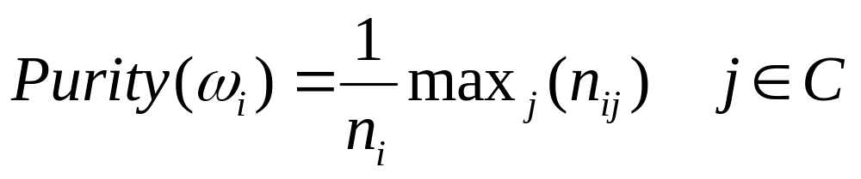
External Evaluation of Cluster Quality
Sec. 16.3
Simple measure: purity, the ratio between the dominant class in the cluster π_{i} and the size of cluster ω_{i}
Biased because having n clusters maximizes purity
Others are entropy of classes in clusters (or mutual information between classes and clusters)

Slide 72
Purity example
Sec. 16.3
• •
• •
• •
• •
• •
• •
• •
• •
•
Cluster I
Cluster II
Cluster III
Cluster I: Purity = 1/6 (max(5, 1, 0)) = 5/6
Cluster II: Purity = 1/6 (max(1, 4, 1)) = 4/6
Cluster III: Purity = 1/5 (max(2, 0, 3)) = 3/5

Slide 73
Rand Index measures between pair decisions. Here RI = 0.68
Sec. 16.3
Number of points | Same Cluster in clustering | Different Clusters in clustering
Same class in ground truth | 20 | 24
Different classes in ground truth | 20 | 72

Slide 74
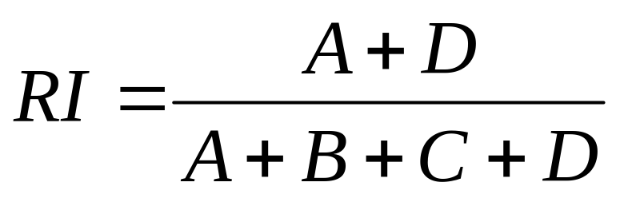
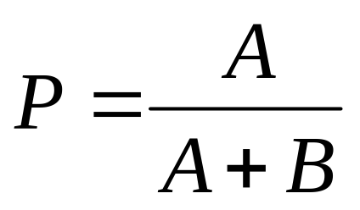
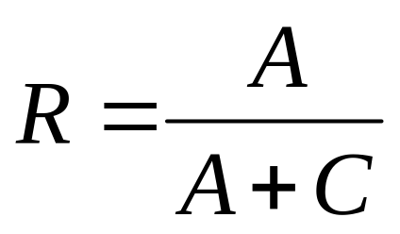
Rand index and Cluster F-measure
Sec. 16.3
Compare with standard Precision and Recall:
People also define and use a cluster F-measure, which is probably a better measure.

Slide 75
Which HAC clustering should I use?
  Don’t use centroid HAC because of inversions.
  In most cases: GAAC is best since it isn’t subject to chaining and sensitivity to outliers.
  However, we can only use GAAC for vector representations.
  For other types of document representations (or if only pairwise similarities for document are available): use complete-link.
  There are also some applications for single-link (e.g., duplicate detection in web search).

Slide 76
  Flat or hierarchical clustering?
  For high efficiency, use flat clustering (or perhaps bisecting k-means)
  For deterministic results: HAC
  When a hierarchical structure is desired: hierarchical algorithm
  HAC also can be applied if K cannot be predetermined (can start without knowing K)

Slide 77
  Major issue in clustering – labeling
  After a clustering algorithm finds a set of clusters: how can they be useful to the end user?
  We need a pithy label for each cluster.
    For example, in search result clustering for “jaguar”, The labels of the three clusters could be “animal”, “car”, and “operating system”.
  Topic of this section: How can we automatically find good labels for clusters?

Slide 78
  Exercise
  Come up with an algorithm for labeling clusters
  Input: a set of documents, partitioned into K clusters (flat clustering)
  Output: A label for each cluster
  Part of the exercise: What types of labels should we consider? Words?

Slide 79
  Discriminative labeling
  To label cluster ω, compare ω with all other clusters
  Find terms or phrases that distinguish ω from the other clusters
  We can use any of the feature selection criteria we introduced in text classification to identify discriminating terms: mutual information, χ² and frequency.
    (but the latter is actually not discriminative)

Slide 80
  Non-discriminative labeling
  Select terms or phrases based solely on information from the cluster itself
  Terms with high weights in the centroid (if we are using a vector space model)
  Non-discriminative methods sometimes select frequent terms that do not distinguish clusters.
  For example, MONDAY, TUESDAY, . . . in newspaper text

Slide 81
  Using titles for labeling clusters
  Terms and phrases are hard to scan and condense into a holistic idea of what the cluster is about.
  Alternative: titles
    For example, the titles of two or three documents that are closest to the centroid.
    Titles are easier to scan than a list of phrases.

Slide 82
  Cluster labeling: Example
 | # docs | labeling method
 |  | centroid | mutual information | title
4 | 622 | oil plant mexico production crude power 000 refinery gas bpd | plant oil production barrels crude bpd mexico dolly capacity petroleum | MEXICO: Hurricane Dolly heads for Mexico coast
9 | 1017 | police security russian people military peace killed told grozny court | police killed military security peace told troops forces rebels people | RUSSIA: Russia’s Lebed meets rebel chief in Chechnya
10 | 1259 | 00 000 tonnes traders futures wheat prices cents september tonne | delivery traders futures tonne tonnes desk wheat prices 000 00 | USA: Export Business - Grain/oilseeds complex
  Three methods: most prominent terms in centroid, differential labeling using MI, title of doc closest to centroid
  All three methods do a pretty good job.

Slide 83
Final word and resources
In clustering, clusters are inferred from the data without human input (unsupervised learning)
However, in practice, it’s a bit less clear: there are many ways of influencing the outcome of clustering: number of clusters, similarity measure, representation of documents, . . .
Resources
  IIR 16
  IIR 17

